Slide 1
PowerShell DSC
(Desired State Configuration) from the Trenches

Slide 2

Get-Help –Name ‘about_Presenter’
Mike F Robbins
Microsoft MVP
SAPIEN Technologies MVP
Leader & Co-Founder of Mississippi PowerShell User Group
Co-Author of Windows PowerShell TFM 4th Edition
Author of Chapter 6 in the PowerShell Deep Dives book
Winner of the Advanced Category in the 2013 Scripting Games
Learn more about me @ mikefrobbins.com

Slide 3
Write-Output ‘Questions for Audience’
IT Pro’s
Developers
Database Administrators
PowerShell
PowerShell version 4 or higher
Functions
Modules
Desired State Configuration
PKI (Public Key Infrastructure)

Slide 4
Set-Content ‘Information to Cover’
Requirements
Imperative versus Declarative Configuration
Basics
MOF
LCM
Push
Pull
Resources

Slide 5
Requirements
PowerShell version 4
KB2883200
WinRM Service
WinRM Listeners (Endpoints)
Script Execution Policy –le Remote Signed
KB3000850 (Recommended)
PowerShell Remoting –not Required

Slide 6
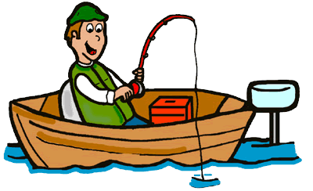

Imperative
Describing an item in terms of specific instructions which changes its state.

Slide 7

Declarative
Describe what you’re trying to achieve without instructing how to perform the specific actions to achieve the state.

Slide 8
Idempotent
Desired state is reached regardless of current state.
Current state is irrelevant.
Produces the same results if executed once or multiple times.
Can be repeated or retried as often as necessary without causing unintended effects.
Non-idempotent operations may need to keep track of whether or not the operation was already performed and what the current state is.

Slide 9

Start-Process ‘Demo’
Demo Code: github.com/mikefrobbins/Presentations

Slide 10
Select-Object –Property ‘Resources’
PowerShell.org
Microsoft Virtual Academy
PowerShell Virtual Chapter of SQL PASS
PowerShell Magazine
GitHub
User Groups
Blogs
Twitter
Windows Desired State Configuration Revealed book
Learning PowerShell DSC book

Slide 11
Thanks for Attending SQL Saturday Baton Rouge 2016!
Speaker evaluations: Use the small square cards at the front of the classroom, give directly to speaker.
Speaker: Please give out 1 book ticket
Book Ticket Winner: Bring your ticket to the user group booth in the main atrium to redeem (supplies limited)

Slide 12

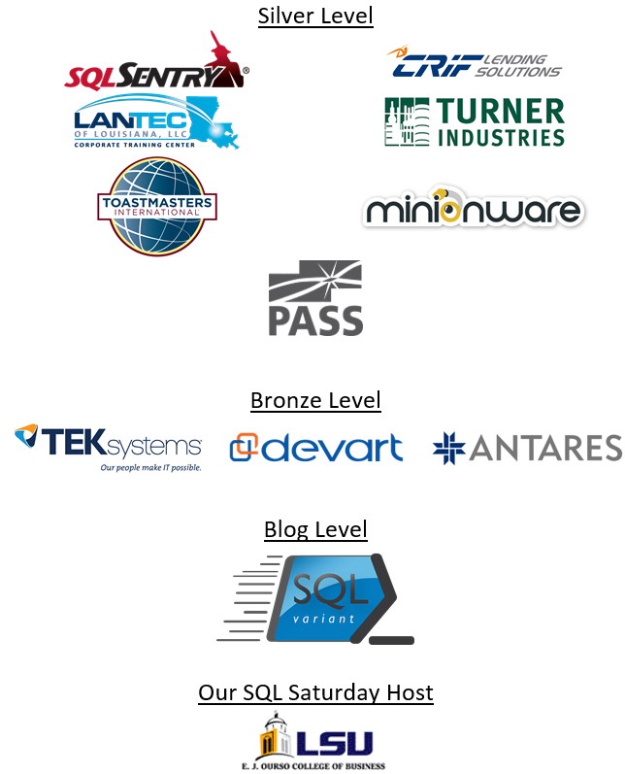


Slide 13

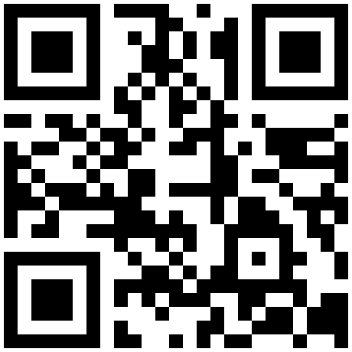

Get-Contact –Identity ‘Presenter’
Blog: mikefrobbins.com (or MrPowerShell.com)
Twitter: @mikefrobbins
LinkedIn: www.linkedin.com/in/mikefrobbins
E-Mail: See mikefrobbins.com/about/
User Group: mspsug.com (or MsPowerShell.com)

